Slide 1
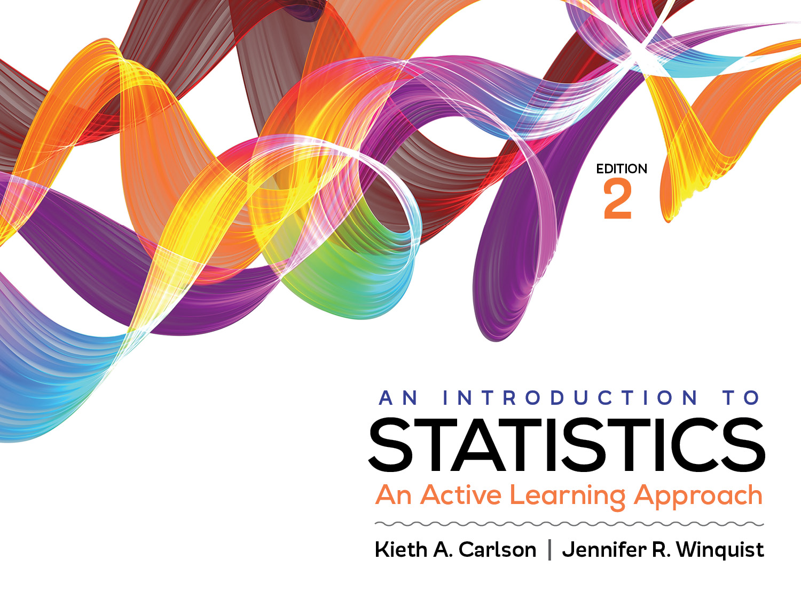
Introduction to Activity 10.3
How to choose the correct statistic

Slide 2
Activity 10.3 will require you to:
Choose the correct significance test for a given scenario
If necessary use Appendix J to help you

Slide 3
Which significance test and why? 1- or 2-tailed?
Is the mean test score of a group of 9th graders higher after watching an instructional video than it was before watching it?
Is this class of students scores different than the national average?
Is the reported happiness of “rich” people higher that the reported happiness of “poor” people?
Notes:
Repeated t test
Single sample t test or z for a sample mean (depending on if you know population standard deviation)
Independent t test

